Slide 1
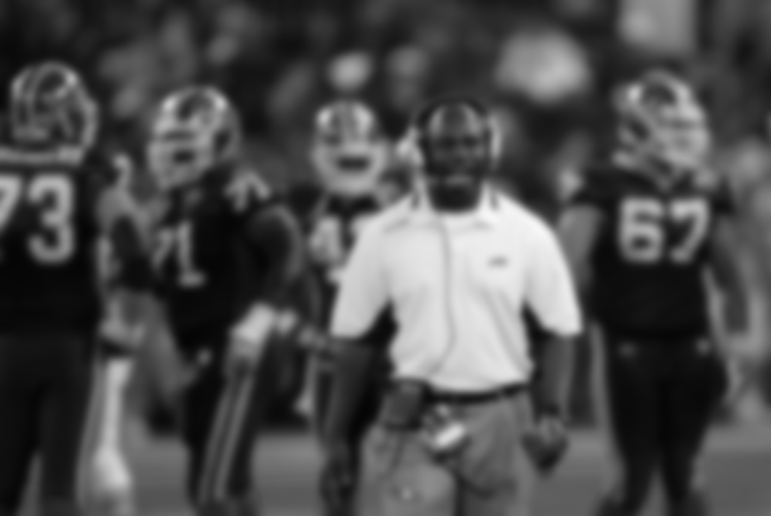

NFL Coaching Value
Will Kinnebrew

Slide 2

Introduction
How do coaches add value, and why do we care?

Slide 3

“Good players can't overcome bad coaching.
— Bill Belichick
Introduction | Why do we care?

Slide 4
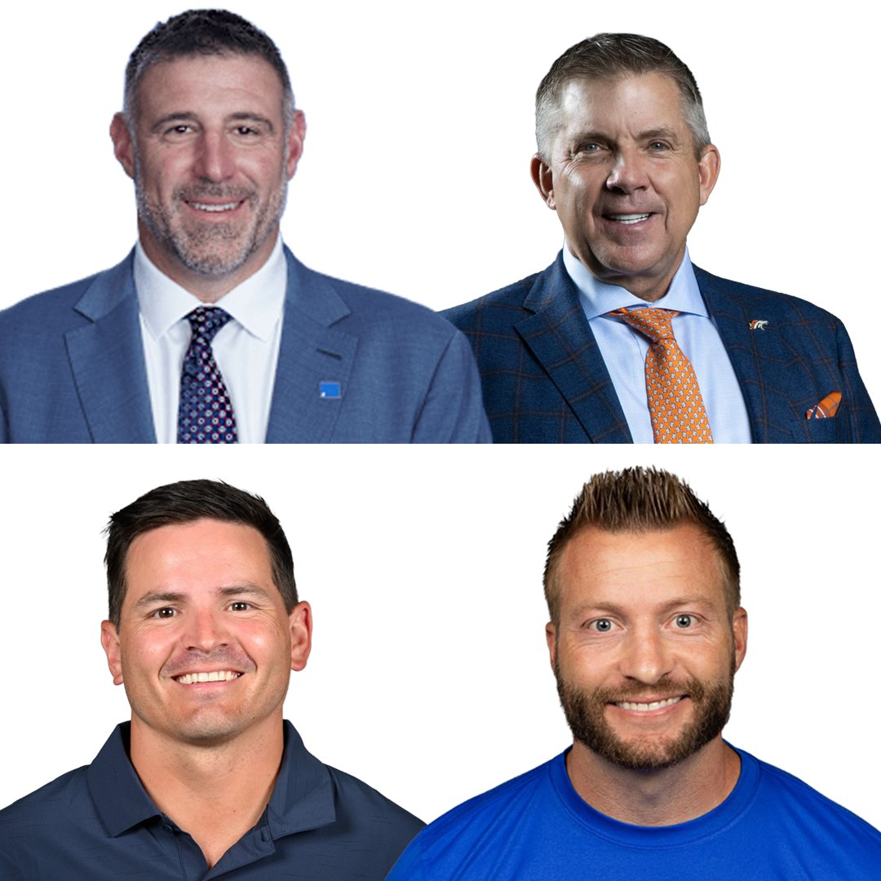
Why do we care?
Vrabel (Patriots) AFC Champion in year 1 (first since 2018).
Macdonald (Seahawks) Superbowl winner in year 2 (first since 2014).
Payton (Broncos) made AFCCG in year 3 (first since 2015).
Super busy hiring cycle this offseason.
No existing metric for coaches.
Introduction | Why do we care?

Slide 5
How do coaches add value?
Player Development; players exceeding expectations
Fourth Downs; good decisions resulting in added epa/wp
Close Games; good decisions resulting in added epa/wp
Regular Season / Playoffs; raw success in regular and post-season
Divisional Games; ability to beat familiar opponents
Clock Management; good decisions resulting in added epa/wp
Introduction | How do coaches add value?

Slide 6
Data & Methodology

Slide 7

.
Data
PFR - Coaches (primary) by team-season ranging back for the entire super-bowl era.
nflfastR - Play by play, season data, etc.
nflreadr - Play by play, season data, etc.

Slide 8
.
Methodology
Create a series of independent “scores” tracking various coaching statistics/metrics.
Combine these scores into a larger cumulative score.
Use this data to highlight top coaching candidates for this year’s cycle.
Create a shiny application to allow users to specify score weights and features.

Slide 9
Modeling

Slide 10
Modeling Process
Close Games; wp% over expected added on plays in 1-score games; percentile by season
Fourth Downs; wp% over expected added on 4th down plays; percentile by season
Crunch Time; wp% over expected added on plays with <= 2min left; percentile by season
Regular Season; percentile ranking of team’s record for that season
Divisional Games; percentile ranking of team’s division game record for that season
Playoffs; percentile ranking of team’s playoff performance (based on what round they exited, if they made it)
Modeling | Scores

Slide 11
Player Development
Hierarchical Bayesian APM
Hierarchical Bayesian model treating every play as an observation of 22 players.
Backups with small sample sizes aren’t over-evaluated, while starters with high snap counts provide precise data.
Accounts for offense or defense and the baseline EPA of the situation.
Quantify how well a coach makes players “overperform” their expected value
APM (Adjusted Plus-Minus) based on EPA
Need to eliminate noise from teammates and game situations to find player’s true impact.
Modeling | Player Development

Slide 12
Player Development
Defining “development”
Development = Observed APM – Expected APM
Expected APM ←
Regression based on prior performance, age and experience, draft position, snap counts
Systemic overperformance across a roster is attributed to coaching quality
Modeling | Player Development

Slide 13
Results & Discussion

Slide 14
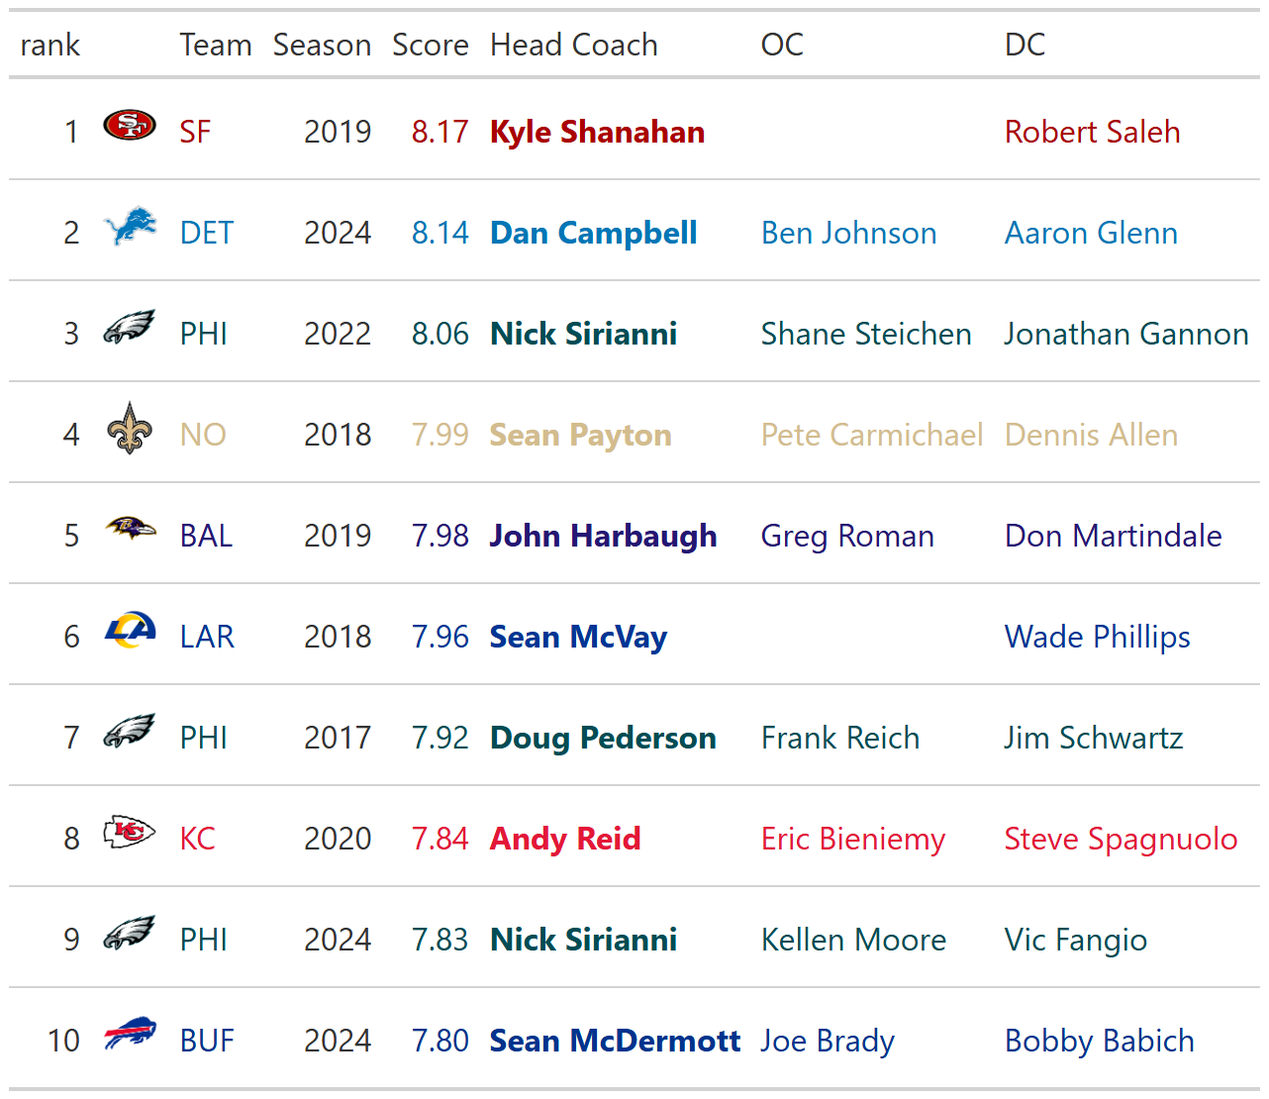
Top Seasons
Since 2017
Results | Top Seasons Since 2017

Slide 15
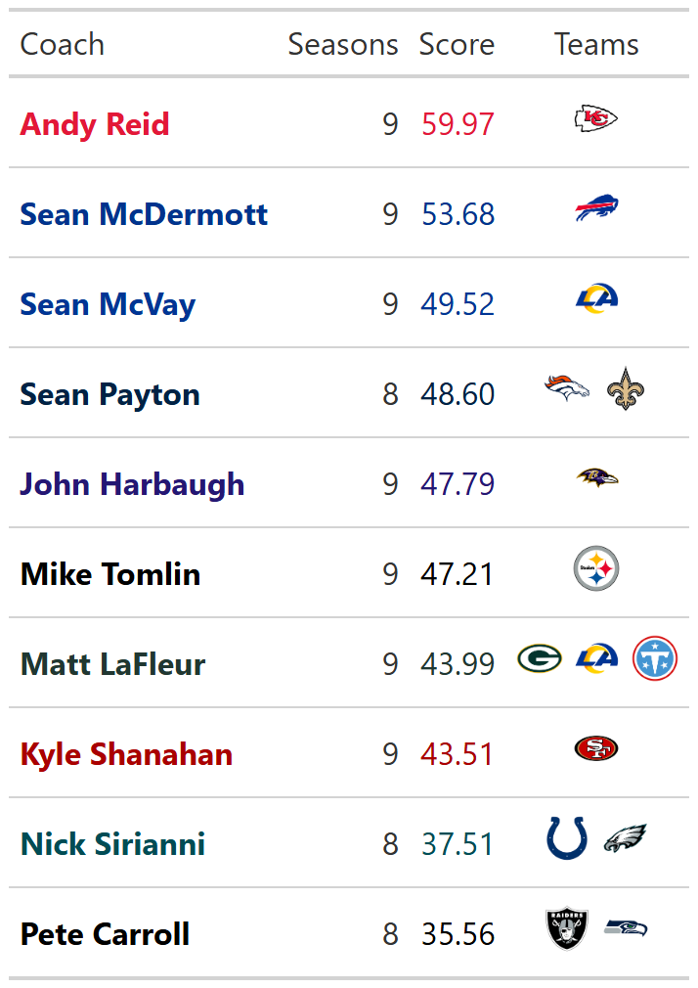
Top Coaches
Since 2017
Results | Top Coaches Since 2017

Slide 16
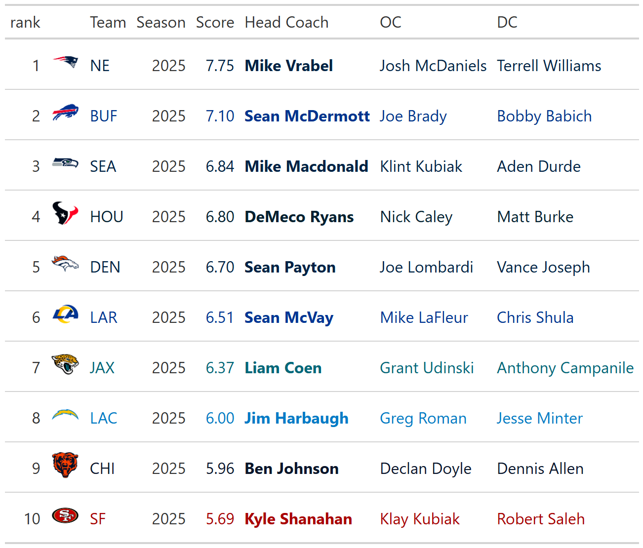
Top Coaches
In 2025
Despite a strong season, McDermott was still fired. This is likely due to the Bill’s inability to make a Superbowl despite their consistent success.
Results | Top Coaches in 2025

Slide 17
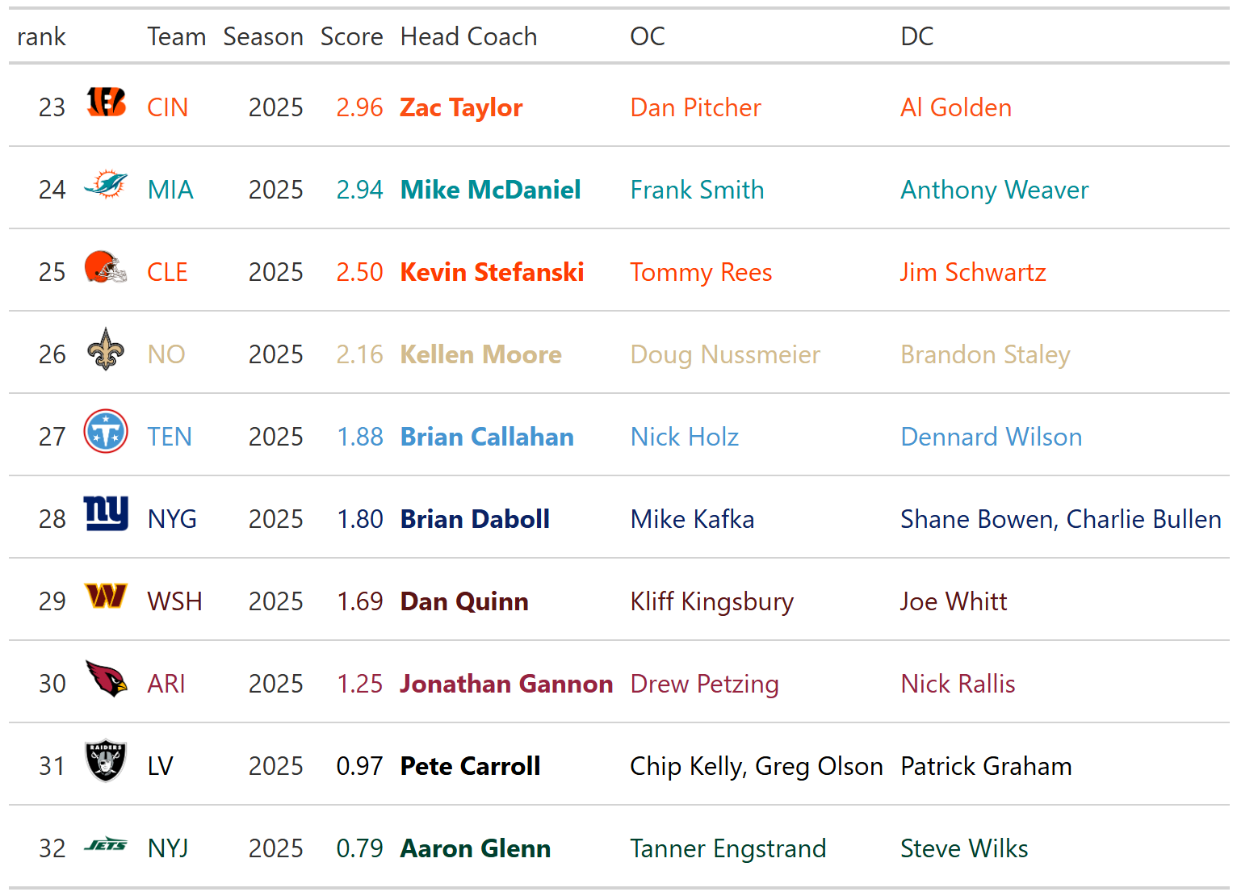
Bottom Coaches
In 2025
Other teams who parted from their coaches include:
BUF (2; Sean McDermott, fired), PIT (11, Mike Tomlin, Resigned),
ATL (18; Raheem Morris, fired), BAL (22; John Harbaugh, fired)
Results | Bottom Coaches in 2025

Slide 18
Hired HC This Cycle
Bills – Joe Brady (2.53*)
Cardinals – Mike LaFleur (2.12*)
Falcons – Kevin Stefanski (3.46)
Ravens – Jesse Minter (2.95*)
Browns – Todd Monken (2.011*)
Raiders – Klint Kubiak (2.28*)
Dolphins – Jeff Hafley (2.5*)
Giants – John Harbaugh (5.31)
Steelers – Mike McCarthy (4.94)
Titans – Robert Saleh (2.14) *only ever an asst coach, so score is out of 4.5
Results | This Cycle

Slide 19
Notable former HC (not hired)
Sean McDermott (5.96)
Doug Pederson (4.59)
Pete Carroll (4.45)
Mike McDaniel (4.29)
Mike Zimmer (4.24)
Results | This Cycle

Slide 20
Notable Asst Coaches (not hired)
Eric Bieniemy; 3.14
Greg Roman; 2.9
Pete Carmichael; 2.78
George Edwards; 2.8
Joe Lombardi; 2.51
Results | This Cycle

Slide 21
Future Work & Areas for Improvement

Slide 22
Future Work & Areas for Improvement
More robust dataset of Coaches allows for more depth
Coaching network would be a great addition – lack of data depth prevents this currently
Inherently best when used with custom weights - Shiny App will improve this

Slide 23
Conclusion
By using various EPA and wp% metrics, we can attribute these residuals to coaches to give an estimate of the literal value they add to their teams.
This information can then be used to not only identify top performing current coaches, but also up and coming assistant coaches that should be targets during a hiring cycle.

Slide 24
Thank You!
Any questions?

